Slide 1

Coaches’ Clinic – Accessories Training
Rogers NHL Accessories Lineup 2014

Slide 2



Sales Flow
Anticipate and Understand your Customer’s Accessory Needs:
Mention accessories while speaking about the device and the Rogers NHL GameCentre LIVE benefits
Example: This Samsung GS5 features a brilliant screen for all of the action on the ice through RGCL. If you like to watch the game on the go, we have a set of accessories in our mobile viewing bundle that offer you a great viewing experience no matter where you are.
Recommend the Accessories and Offer a Complete Solution:
Once the customer selects the device, bring out the accessories and show how they fit the customer’s lifestyle and preferences.
Example: Being able to watch hockey on the go with NHL GameCentre LIVE is so exciting. Here is a <Customer’s favourite team> mobile viewing that would help you enjoy the game, wherever you are.”
Overcoming Objections and Closing the Sale:
Find out the reason why the customer is hesitant or “Wants to think about it” and position the bundle as a way to overcome these objections and benefit the customer
Remember that many of these NHL team branded mobile accessories are only available at Rogers

Slide 3
Product Positioning
NHL Team Branded Mobile Accessories are the perfect complement to complete the mobile viewing experience provided by Rogers GameCentre LIVE.
For the ardent hockey fan that is always on the go and wants to catch all of the action on the ice, these accessories makes sure your device stays game ready:
Get Loud:
Hear the action on the go and share the excitement on the ice with your friends using the wireless bluetooth speakers. Not in hometown territory? Enjoy the action while keeping it on the low down with the in-ear headphones.
Get Proud:
Wear your device proudly with your choice of gel skin, aluminum or leather cases with your favourite teams logos.
Get Energized:
Game headed to overtime? Make sure your device stays powered and ready for overtime with our NHL branded wall chargers, car charger and portable charger. Don’t forget the right cable for your device!

Slide 4
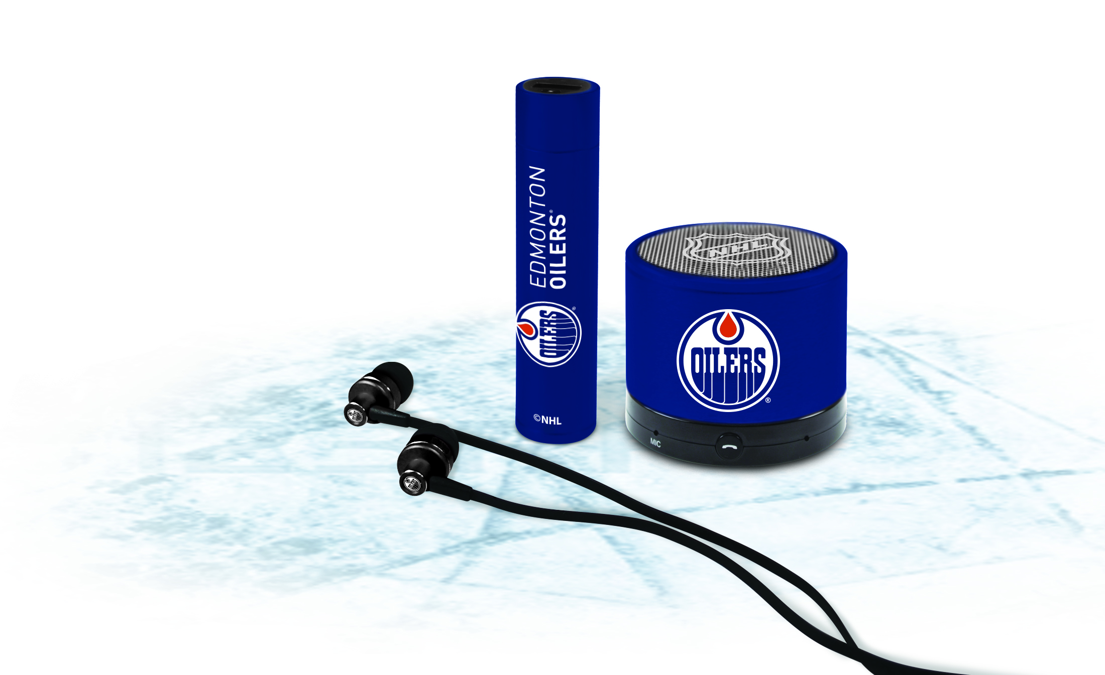










Selling Tools – Get Game Ready:
Mobile Viewing Bundle:
Rogers exclusive NHL Team branded accessories
Products featured in the Mobile Viewing Bundle:
Logiix Piston Play Bluetooth Speaker
Logiix Piston TuneFreqs In-ear earphones
Logiix Piston Power Portable Power Charger
Great value for the customer: Get the accessories and a great viewing experience for only $79.99
Original retail value of all the items separately: $120.00
 | Mobile Viewing Bundle - Rogers Exclusive NHL Team Branded Product
Contents | Logiix Piston Play Bluetooth Speaker Logiix TuneFreqs In-ear earphones Logiix Piston Power Portable Power Charger
Differentiator | Get ready for a complete mobile viewing experience
MSRP | $79.99
Available For:

Slide 5
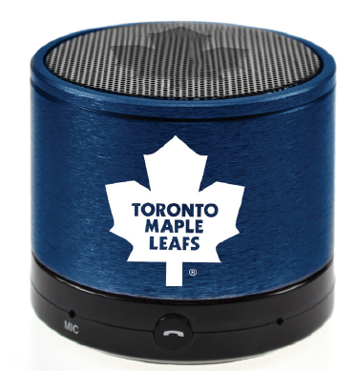
Selling Tools – Get Loud:
Logiix Piston Play Bluetooth Speaker:
Available as part of the viewing bundle and also separately
Share the excitement of the NHL game with your friends
With the custom 3W HD audio driver hear the action loud and clear. Celebrating with some tunes after the game? The Logiix Piston is great for music as well
Chatting about the game? The Piston Play comes with a handsfree microphone, and a answer call button so you can hold your own phone conference about your team’s on-ice performance
Durable aluminum finish and compact design: Take it anywhere you go and enjoy
Logiix Piston Play Bluetooth Speaker - Rogers Exclusive NHL Team Branded Product
Audio Output | 3W Custom HD audio driver for clear and crisp sound
Battery Life and Capacity | Equipped with a 3.7v Li-ion 900mAh battery. Stay tuned into the game with up to 8 hours of play-time or 4 hours of talk-time
Charging Time | Fully charges up in 2.5 hours - spend less time in the penalty box charging, and more time listening and watching!
Material & Construction | Durable Aluminum Finish
MSRP | $49.99
Available For:

Slide 6
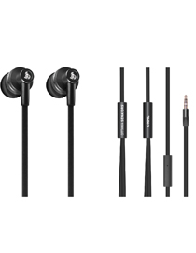
Selling Tools – Get Loud
Logiix TuneFreqs In-ear Headphones:
Available as part of viewing bundle and also separately
Immersive yourself in the game during your commute with full stereo sound
11.5mm drivers produces rich and clear sound, for the hockey game, or for music
Durable aluminum housing and flexible cable for portability and durability
In-Line microphone and controls allows you easy control of the volume, control music track settings or to take calls
Logiix TuneFreqs In-ear Headphones - Rogers Exclusive NHL Team Branded Product
Driver Size | 11.5mm driver for rich and clear sound
Cable Length | 102.5cm (Just over 1m in length)
Controls | In-line microphone and controls for ease of control
Material & Construction | Aluminum housing for portability, yet toughness
MSRP | $34.99
Available For:

Slide 7
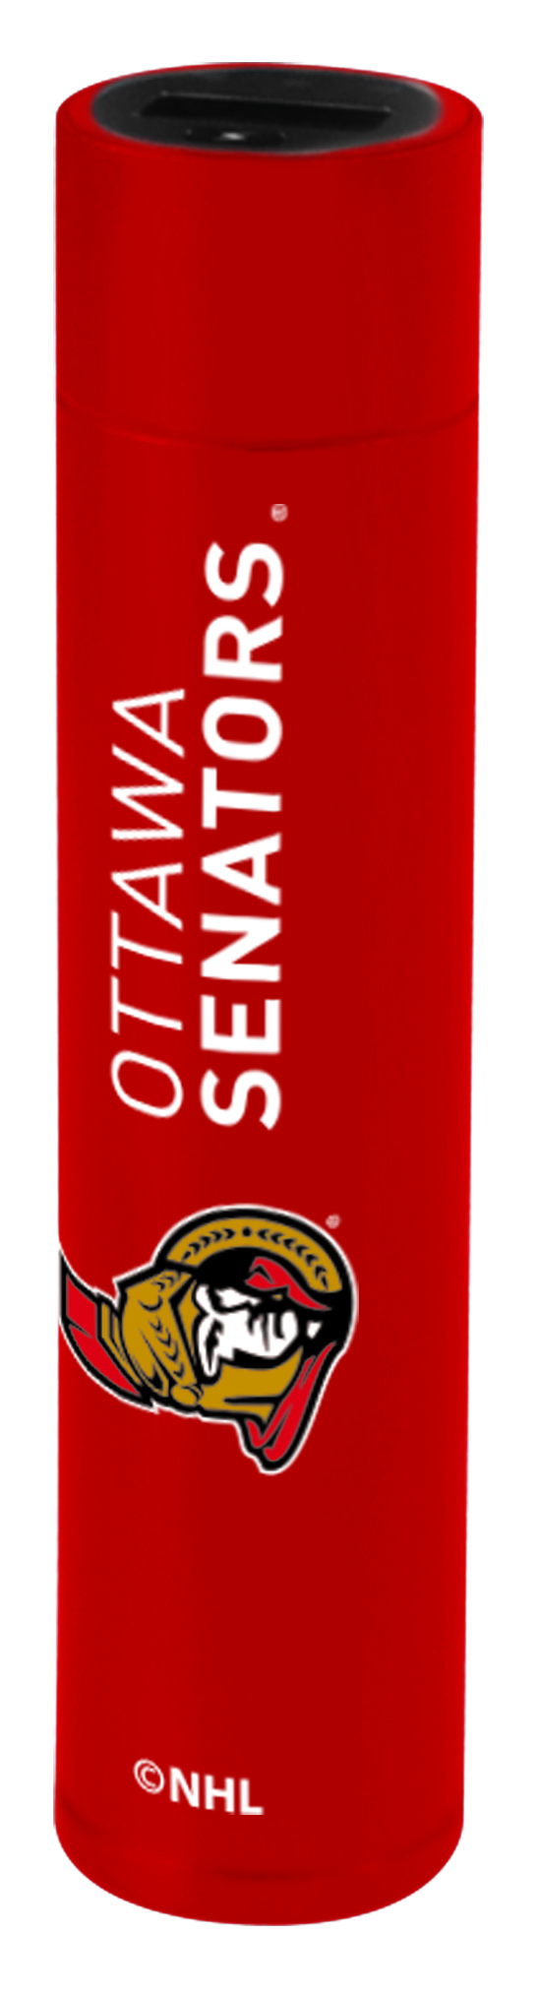
Selling Tools – Get Energized
Logiix Piston Power Portable Charger:
Available as part of viewing bundle and also separately
Portable Power chargers are convenient, and provide an instant “pick-me-up” for your device
When watching mobile video such as Rogers NHL GameCenter LIVE, your device consumes battery power faster than usual
Ensure that your customers’ device is ready for overtime with a Logiix Portable Power charger
Does not include a cable - Make sure that the customer picks up the appropriate sync/charging cable for his/her device (MicroUSB or Lightning)
Logiix Piston Power Portable Charger - Rogers Exclusive NHL Team Branded Product
Material & Construction | Durable Aluminum Shell
Battery Capacity | 3,000mAh Built-in Lithium-ion battery Holds enough charge to recharge most smartphones up to 3 times
Power Output | USB: 5v/1A Easily plug in and charge your smartphone
MSRP | $34.99
Available For:

Slide 8
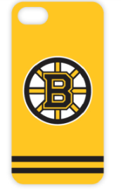
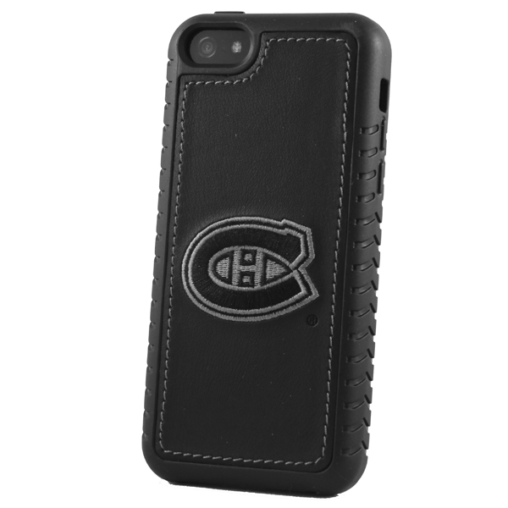
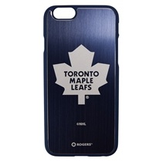

Selling Tools – Get Proud:
Licensed NHL team logo cases:
Available separately (not part of mobile viewing bundle)
Show your team pride and keep your device protected with these NHL team logo cases
Choose between gel skin, premium leather and aluminum for different looks and style
 | Logiix Gel Guard Case -Rogers Exclusive NHL Team Branded Product | Gentec Premium Leather Case | Logiix Aluminum Shield Case - Rogers Exclusive NHL Team Branded Product
Image:
Material | TPU Gel skin | Leather | Aluminum
Logo | Painted | Embroidered | Laser Etched
Differentiator | Slim, light and bright | Classic, fashionable look | Sleek and Tough
MSRP | $19.99 | $24.99 | $29.99
Available For | All 30 NHL teams online, Select teams in store |  | All 30 NHL teams online, Select teams in store

Slide 9
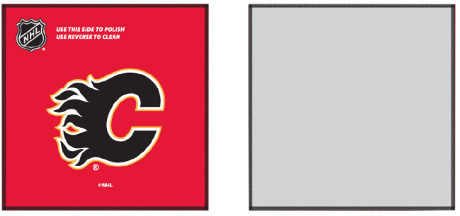
Selling Tools – Get Proud:
Logiix Micro Cloth Screen Cleaner:
Available separately (not part of mobile viewing bundle)
You can’t use a ice re-surfacer on your device, but you can use these NHL team logo screen cleaner kits to give your device a shine
Dual Side: 1 side for cleaning and 1 side for polishing
Microfiber cloth gently cleans away dirt, smudges without damaging your screen
 | Logiix Micro Cloth - Rogers Exclusive NHL Team Branded Product
Image:
Material | Microfiber cloth gently cleans away dirt, smudges without damaging your screen
Available For:
MSRP | $6.99

Slide 10
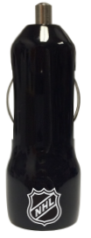
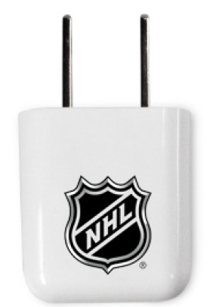
Selling Tools – Get Energized
Car and Wall Chargers:
Available separately (not part of mobile viewing bundle)
Make sure that the customer picks up the appropriate sync/charging cable for his/her device (MicroUSB or Lightning)
Logiix Power Lite Car Charger (DC) – Rogers Exclusive NHL Branded Product
Material & Construction | High Gloss Finish
Input | DC Car charger – Plugs into the 12V /Cigarette Lighter plug
Outputs | 2 USB Outputs Charge a smartphone, as well as another device (i.e: bluetooth headset) at the same time
Output | 1st USB output: 2.4A/12W, 2nd USB Output: 1.0A/5W Use the 2.4A USB output to charge your phone/tablet faster
NHL | Available with NHL logo
MSRP | $19.99
Logiix Power Cube Wall Charger (AC) - Rogers Exclusive NHL Branded Product
Material & Construction | High Gloss Finish
Output | USB: 5v/2.1A Compatible with the latest power hungry smartphones and tablets
NHL | Available with NHL logo
MSRP | $24.99

Slide 11
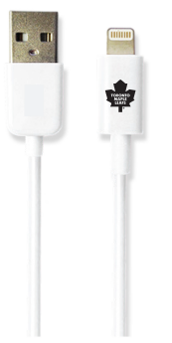
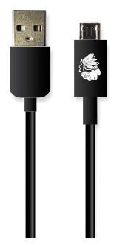
Selling Tools – Get Energized
Syncing and Charge Cables:
Make sure that your customer has a charge/sync cable with their car/wall charging adapter
Logiix Lightning Sync & Charge Cable - Rogers Exclusive NHL Branded Product
Material & Construction | Durable Polycarbonate Housing, Slim USB and Lightning connectors
Length | 1 Meter
Compatibility | Apple iOS Devices: iPhone 5/5c/5s/6, iPad, iPad Mini, iPad Air, iPod Touch (5th Gen.), iPod Nano (7th Gen.)
Certification | Apple Made For iPhone (MFI) Certified Apple Certified to ensure reliability and compatibility
Colours | Available in white
NHL | Available with logos of all 30 NHL teams
MSRP | $24.99
Logiix MicroUSB Sync & Charge Cable - Rogers Exclusive NHL Branded Product
Material & Construction | Durable Polycarbonate Housing, Slim USB and MicroUSB connectors
Length | 1 Meter
Compatibility | All devices with MicroUSB charging ports
Colours | Available in black
NHL | Available with logos of all 30 NHL teams
MSRP | $14.99

